Slide 1
DATA VISUALISATION
PROFESSOR : DR. TAM NGUYEN
Team Members
Surya Venkatesh Vijjana
Shravya Reddy Akmy
Manasa Metta
Meghana Ayyalasomayajula
Anirudh Reddy Koppurapu

Slide 2
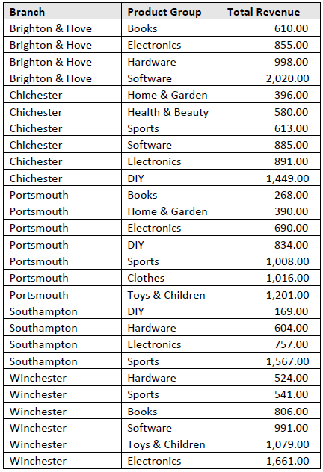
Problem 01
For this problem, we need to generate nested tree-map
( grouped by Branch ).

Slide 3
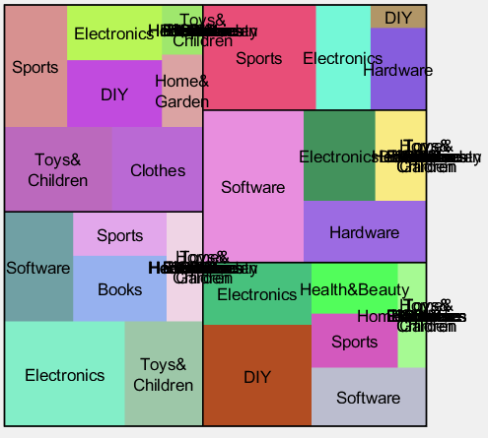
Issues
When label data is given as an input without grouping (by Product Group ), labels are overwritten in each sub-treemap.
Unable to add headers to each tree-map in the nested tree-map.

Slide 4
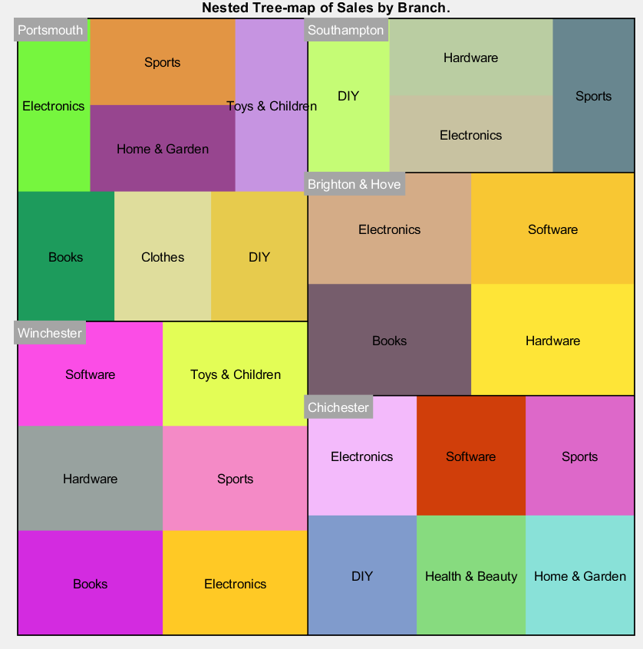
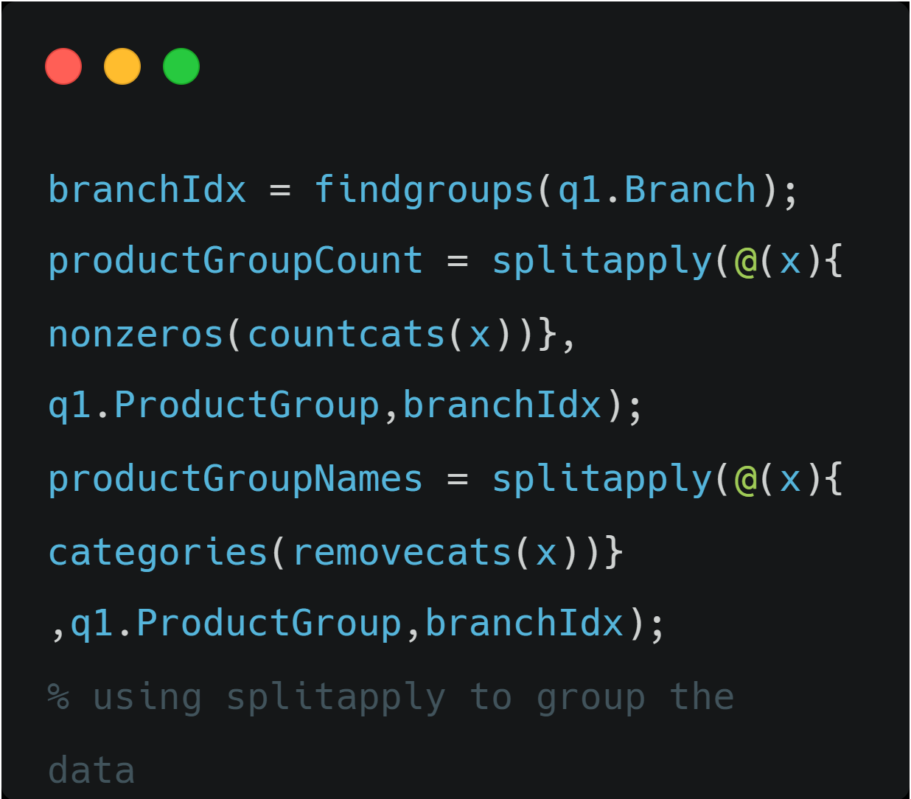
Solution & Final Output
To fix the issue of overwritten labels, used splitapply() function in MATLAB to group the data.

Slide 5
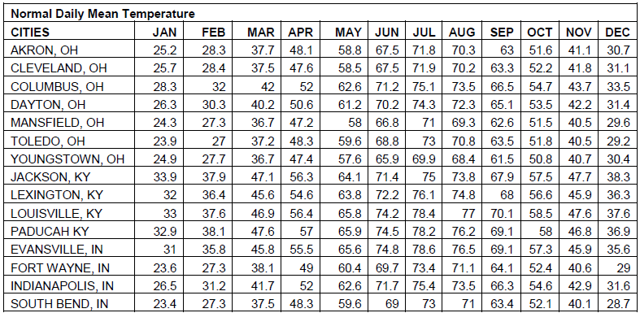
Problem 02
Given the normal daily mean temperature (oF) of some cities in the Greater Cincinnati Tri-State Area, Ohio, Kentucky, and Indiana.
We need to generate heatmap of the mean temperature
for each month on the tri-state map.

Slide 6
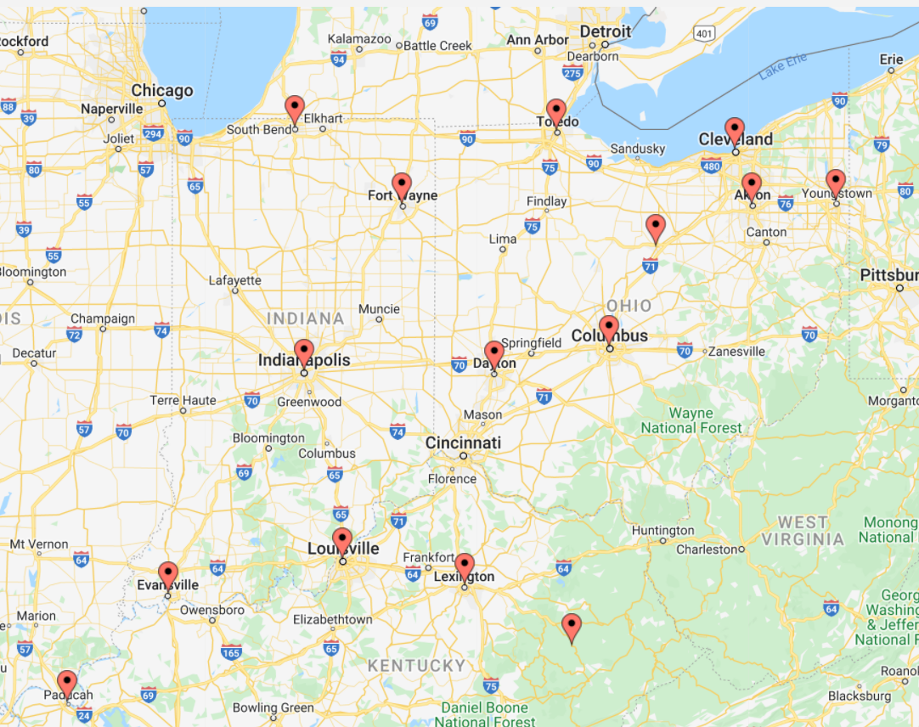
Issues
Finding a Tri-state Map with the specified locations is tough as satellite view map looks cluttered.
Projected heatmaps for each location isn’t perfectly aligned with their co-ordinates.

Slide 7
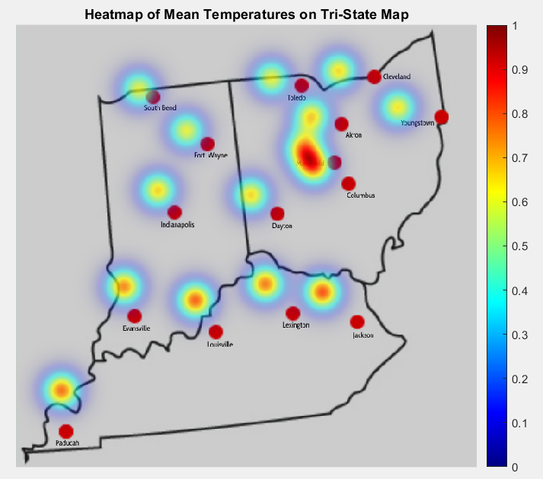
Solution & Final Output
In order to avoid cluttering, we took a Tri-state border outline map and manually labelled the specified locations.

Slide 8
Problem 03
Provided the data file World Bank CO2.xlsx, We need to Create seven distinct visualizations for this data file by using Tableau.

Slide 9
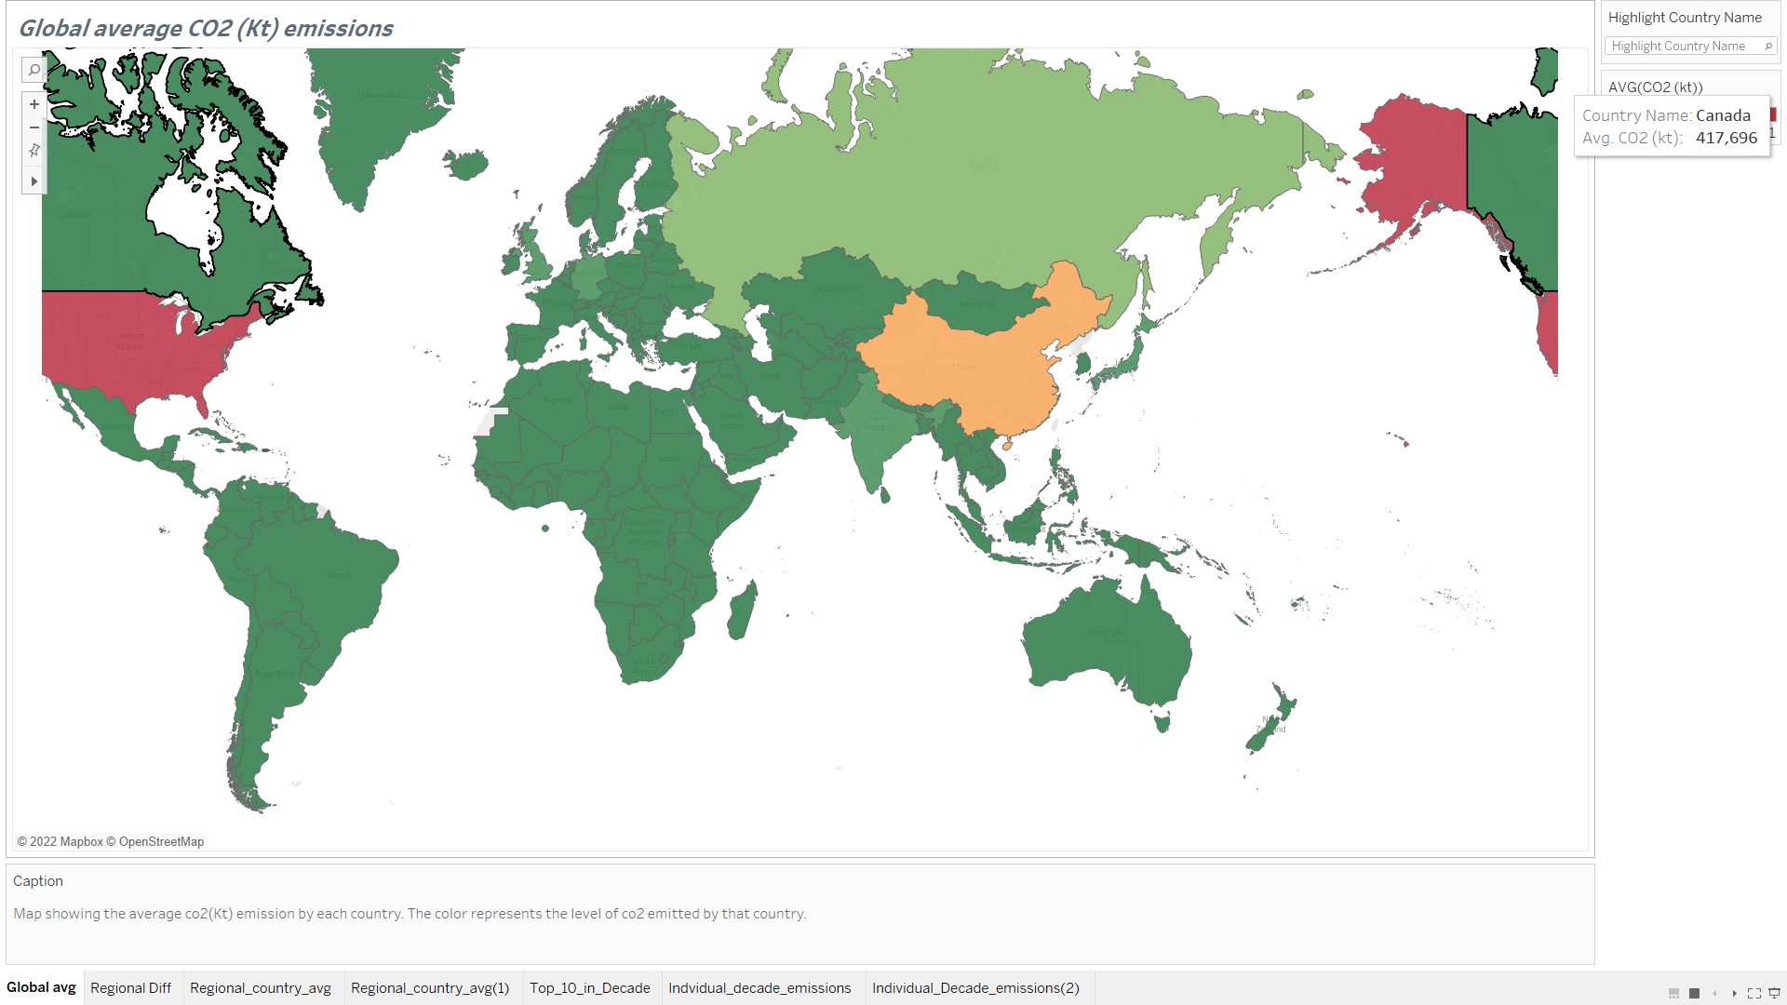
Final Output

Slide 10
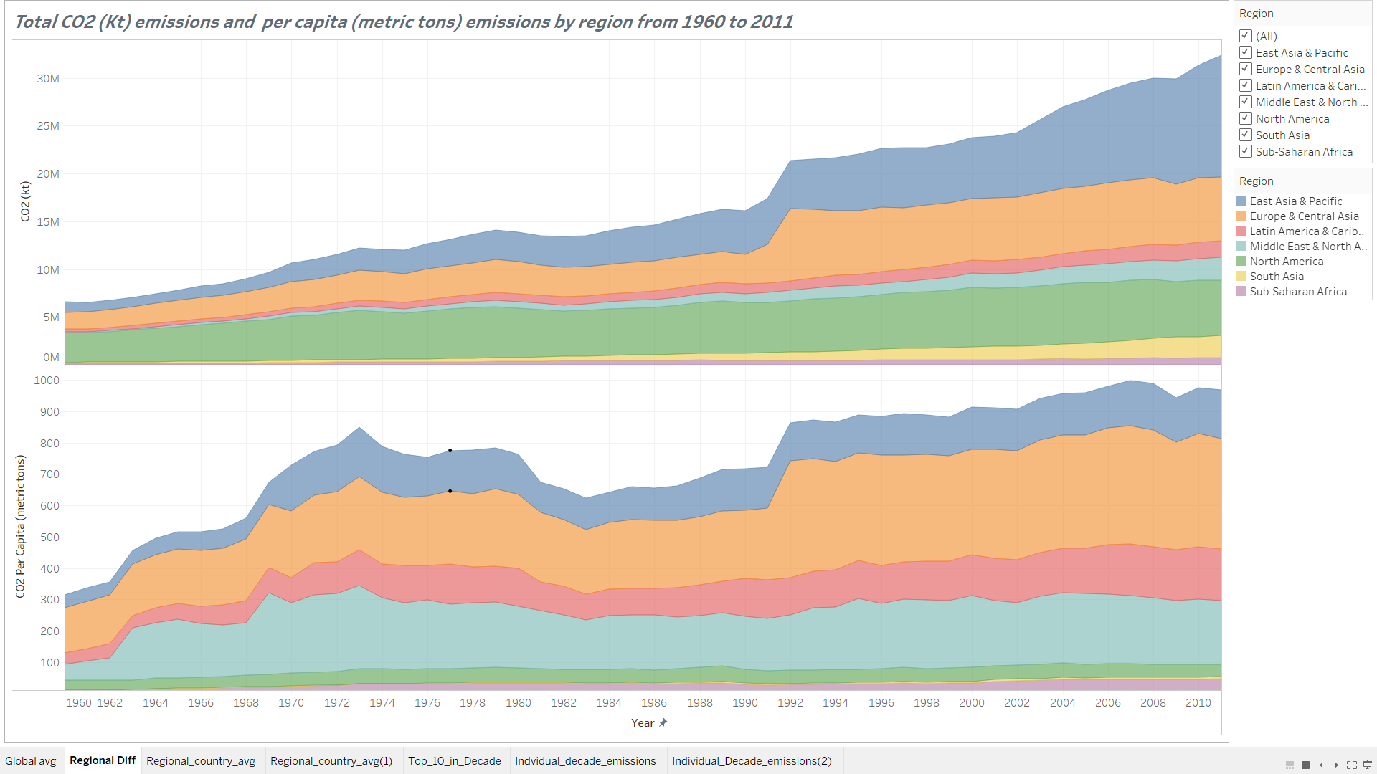
Final Output

Slide 11
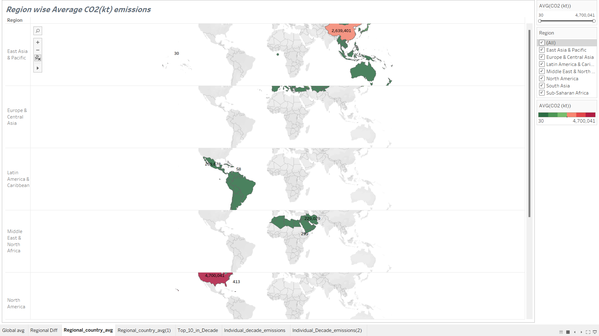
Final Output

Slide 12
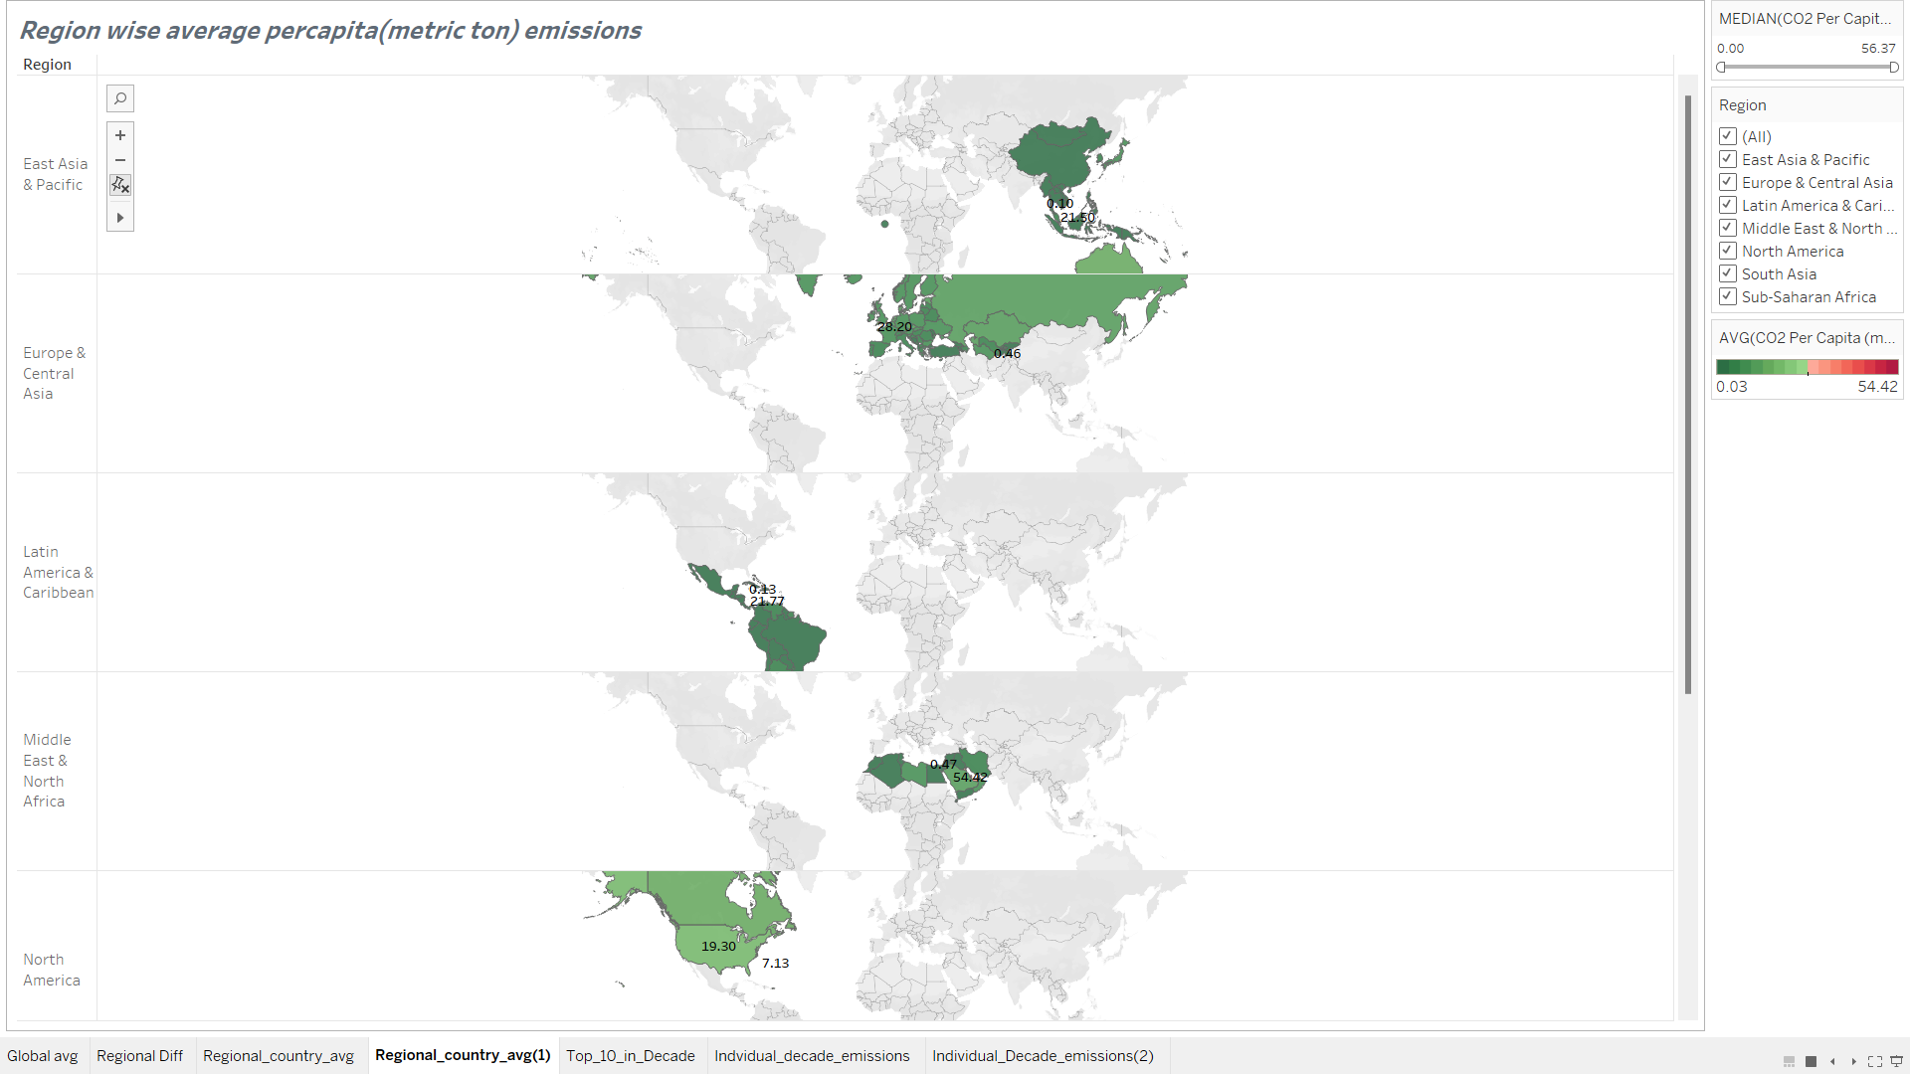
Final Output

Slide 13
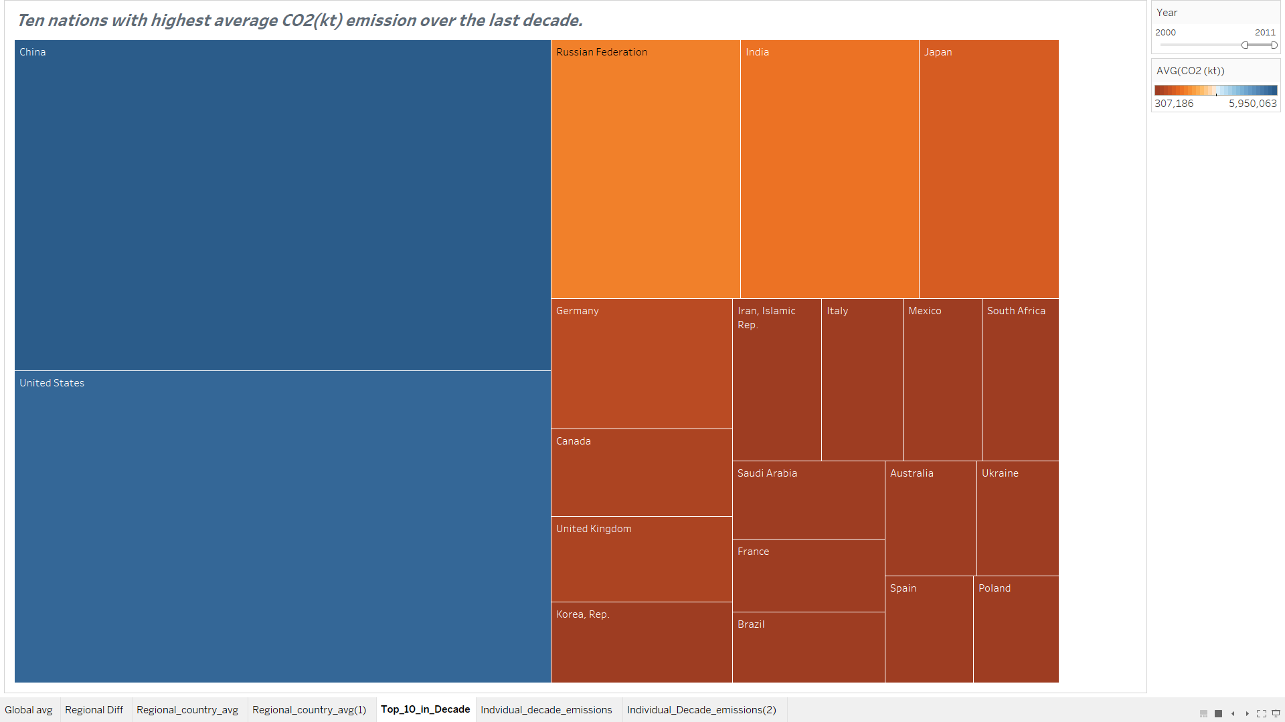
Final Output

Slide 14
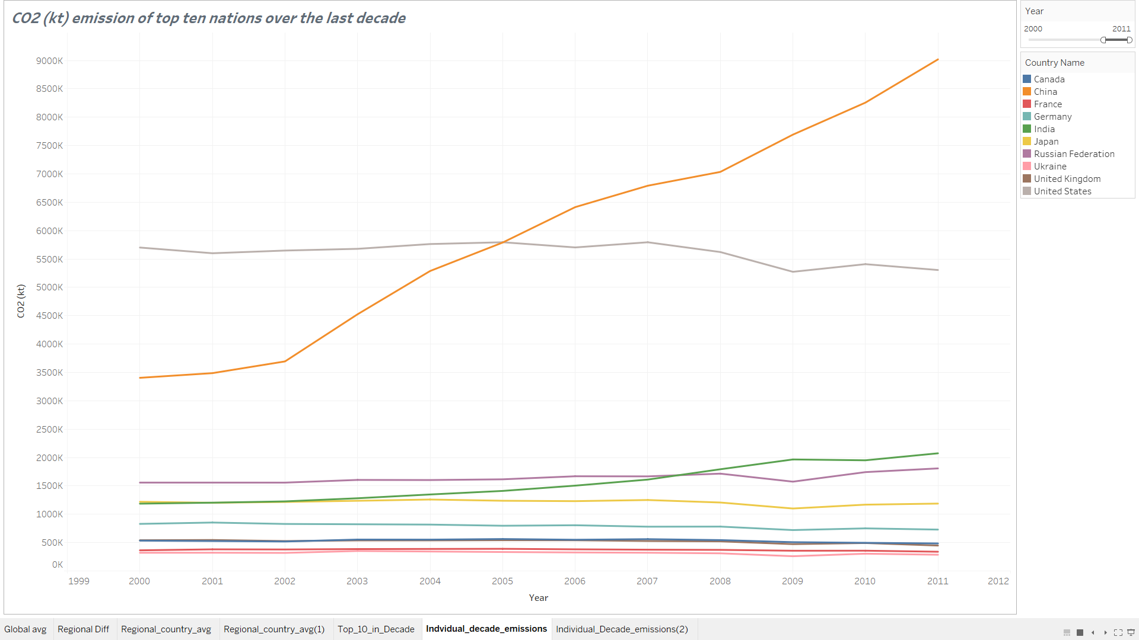
Final Output

Slide 15
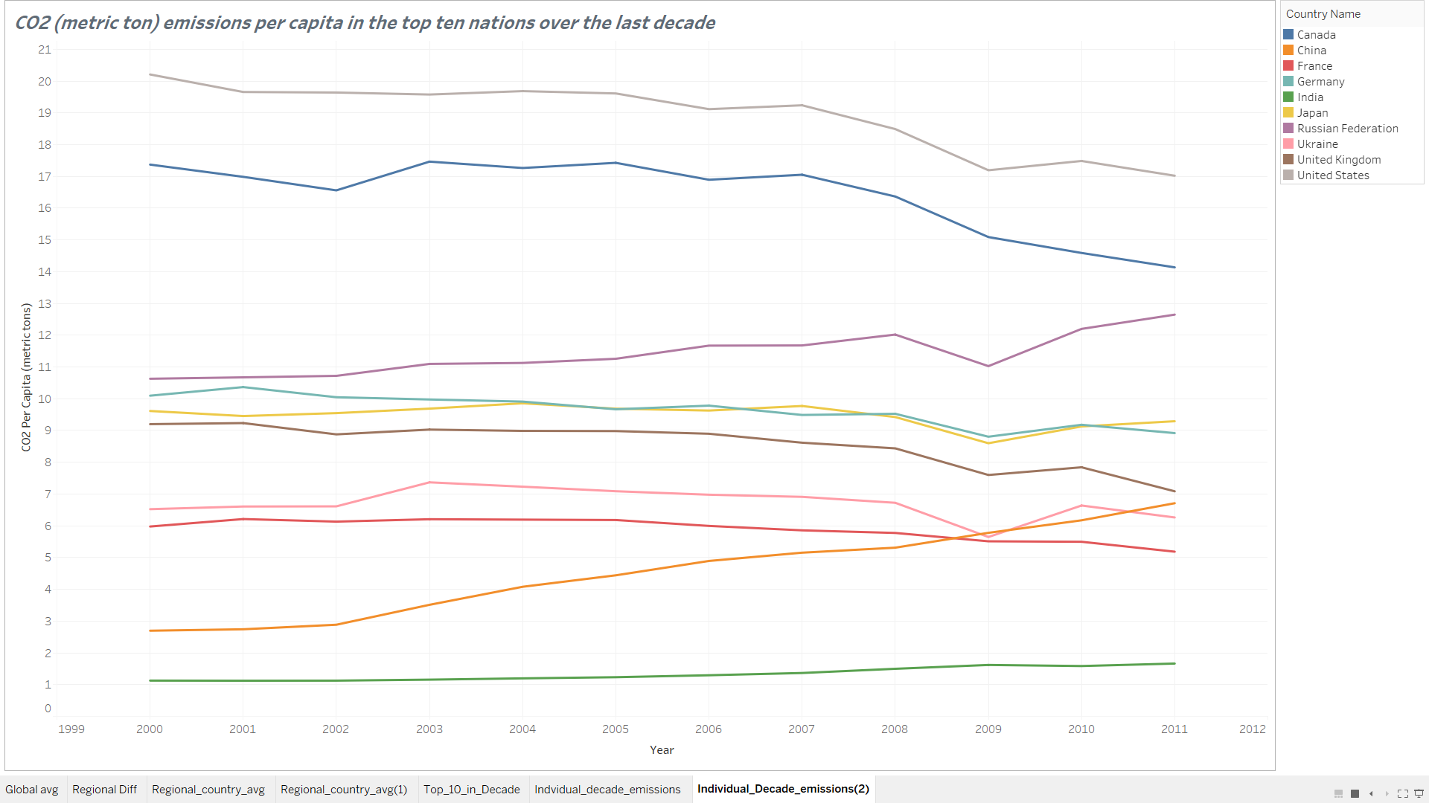
Final Output

Slide 16


